Slide 1
2nd Grade

Slide 2
This is our typical schedule.
7:45 - 8:15 Morning Routine
8:15 – 9:45 Math Workshop
9:45 – 11:25 Reading Workshop
11:25 – 11:55 Lunch
11:55 – 12:25 Phonics
12:25 – 1:00 Writing/ Grammar
1:00 – 1:30 Playground
1:30 – 2:10 Science/ Social Studies
2:10 -2:25 Dismissal Routine
Daily Schedule

Slide 3
Email – sipling.brandy.a@muscogee.k12.ga.us
School phone- 706-569-3664
Class website- http://siplingcubs.weebly.com/
Contact Information

Slide 4
Each day your child will bring home his/ her binder.
Included in the binder-
Homework (due Fridays)
Reading log (due Fridays)
Place for notes/ money(please label)
Daily Agenda (please sign daily)/ behavior notes
Classwork-not graded (review at home)
Take- home reading envelope (due the next day)
BEAR binder

Slide 5
On Mondays, your child will bring you a cub report with weekly graded papers. Please keep papers and return signed folder to school. Infinite Campus is also updated for current averages in each subject.
Grades

Slide 6
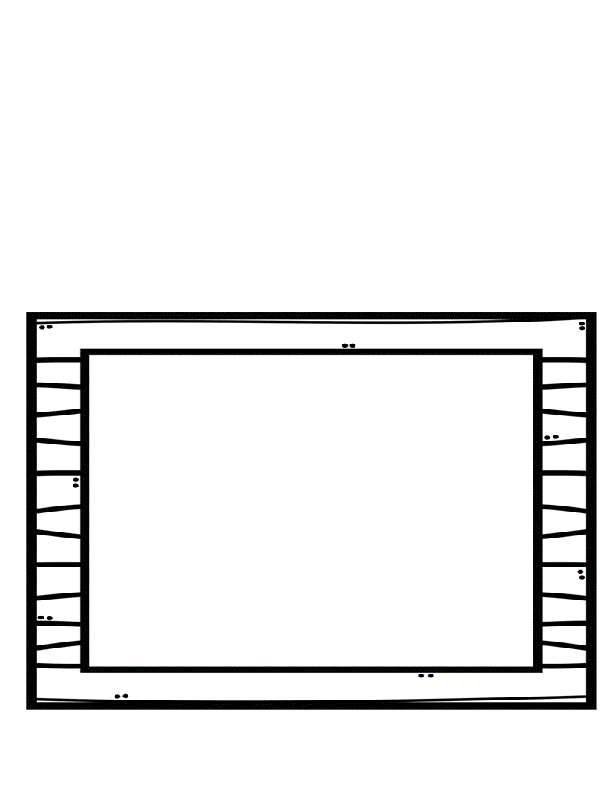
We use the Reading Wonders series. Please use the website to practice the weekly reading skills. http://connected.mcgraw-hill.com/connected/login.do
Weekly comprehension tests are taken online in the computer lab.
Reading

Slide 7
As a way to improve comprehension, we use the AR program. Use http://www.arbookfind.com to help find books for your child’s level. Throughout the year there are many goals and rewards for reaching these goals.
Homework includes reading 20 minutes nightly.
Accelerated Reader

Slide 8
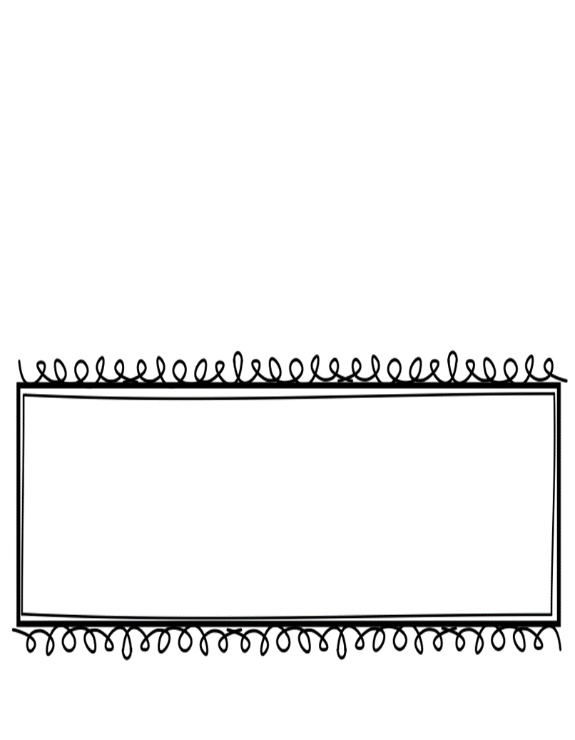
We use the Envision math program. Please use the following website for practice. https://www.pearsonsuccessnet.com/
Another part of 2nd grade math is mastery of addition/ subtraction facts to 20.
Math

